Slide 1

Learning
An Introduction to Programming in Python
Notes:
Let's learn about Learning.

Slide 2

Learning to Program Can Be Hard
Notes:
Some people think that learning to program is frustrating.
We've designed this course to not be frustrating, but sometimes it will be.
Learning a new subject can be hard.
However, keeping a few things in mind may help with this.

Slide 3

The Alleged "Geek Gene"
Notes:
One of the biggest misconceptions about computing is that some people can learn it and some people can't.
There is plenty of evidence against this idea, but it persists.
Some people may take more time than others, but that's true of anything.

Slide 4

Good Attitude
Notes:
So what determines if you'll be good at programming?
A lot of evidence suggests that it comes down to having a good attitude.
Believe that you can learn the material, given time and practice.

Slide 5
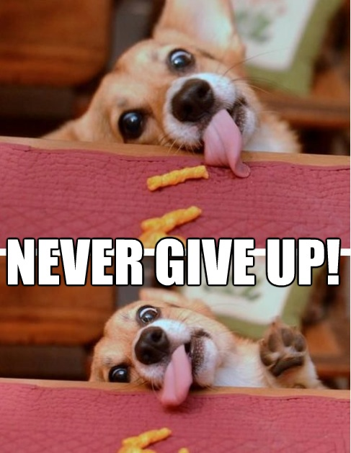
Mastery learning
Notes:
Keep trying until you get it.
Never say, "I failed on the first attempt, so I can't do it."

Slide 6
Getting Help
Help Sources:
Instructor
Teaching Assistants
Friends in the course
The internet
…
Notes:
If you've spent an hour on a problem and have made no progress, then GET HELP.
Ask the instructor, ask a TA, ask a friend.
Get help from SOMEONE.

Slide 7
Working Early, Briefly, and Often
Early
Start when the assignment is first given
Briefly
Do not work to exhaustion
Often
Aim for regular practice rather than huge gaps
Notes:
The absolute best way to do well in this course is to get started on work as soon as it is assigned.
Do not work for long periods of time.
Instead, work in short consistent bursts.
Scheduling 1-2 hours every day to work on this material is much better than doing it all the night it is due.

